Slide 1


LLM PROBE
AN ACTIVATION-BASED DETECTION OF MEMORIZATION AND HALLUCINATION
IN LARGE LANGUAGE MODELS
Department Of Artificial Intelligence and Machine Learning
Third Review
Team Members
Jayachandran K - 23619211
Praveen R - 23619225
Mohamed Ziprees Z - 23619221
Project Guide
Ms. Benasir Begam.F M.E, (Ph.D)
Batch No: 8

Slide 2
ABSTRACT
Problem: LLMs raise two reliability concerns during generation — memorization (verbatim reproduction of training data, raising copyright/privacy issues) and hallucination (fluent but factually unsupported content).
Gap in existing work: Current detection methods for both problems depend on external verification — reference-corpus comparison for memorization, fact-checking pipelines for hallucination — making them computationally expensive and unusable in real time.
Proposed approach: LLM Probe detects both phenomena directly from a open weight model's internal activations during a single forward pass, without external lookup or post-hoc verification, using an open-weight LLM.
Extension: The same methodology is designed to extend to a third task — detecting circumvented safety guardrails — explored as time permits beyond the two core contributions.

Slide 3
PROBLEM STATEMENT
Large language models can silently reproduce memorized training data or generate confident but factually incorrect (hallucinated) content, and both failure modes are invisible from the output text alone.
Existing detection methods rely on external verification (corpus lookup, LLM-as-judge) that is computationally expensive and treats the model as a black box.
This project investigates whether these failure modes can instead be detected intrinsically, in real time, from the model's own internal activations during generation.

Slide 4
OBJECTIVES
  Develop and analyze an open weight LLM-internal probes by creating reliable labeled datasets, extracting layer-wise activations, identifying informative layers using Cohen’s d, and training lightweight classifiers to detect memorization and hallucination without external retrieval.
  Evaluate and demonstrate generalization by testing the probes on held-out categories and developing a live token-by-token inference system that visualizes memorization and hallucination risk in real time.

Slide 5
LITERATURE REVIEW
S.no | Title | Authors | Summary | Disadvantages | Advantages
1 | Memorization or Interpolation? Detecting LLM Memorization through Input Perturbation Analysis (PEARL) (2025) | Albérick Euraste Djiré, Abdoul Kader Kaboré, Earl T. Barr, Jacques Klein, Tegawendé F. Bissyandé | Detects LLM memorization by applying input perturbations and analyzing changes in the model's outputs. | 1. Does not access internal model activations. 2. Provides limited information about which layers contain memorization signals. 3. Relies on output behavior rather than internal representations. | 1. Detects memorization without accessing model internals. 2. Uses output behavior to identify memorization. 3. Can be applied as a black-box approach.
2 | Data Portraits: Recording Foundation Model Training Data (2023) | Marc Marone, Benjamin Van Durme | Uses compact data sketches to determine whether generated content exists in a foundation model's training corpus. | 1. Requires access to the training corpus. 2. Does not directly analyze internal model representations. 3. Difficult to apply when the original training data is unavailable. | 1. Efficiently searches for training-data presence. 2. Useful for studying training-data memorization. 3. Can identify potential training-data membership.

Slide 6
S.no | Title | Authors | Summary | Advantages | Disadvantages
3 | FActScore: Fine-grained Atomic Evaluation of Factual Precision in Long Form Text Generation (2023) | Sewon Min, Kalpesh Krishna, Xinxi Lyu, Mike Lewis, Wen-tau Yih, Pang Wei Koh, Mohit Iyyer, Luke Zettlemoyer, Hannaneh Hajishirzi | Breaks generated text into atomic facts and verifies them against trusted sources to measure factual precision. | 1. Provides fine-grained factuality evaluation. 2. Evaluates individual claims. 3. Uses trusted sources for verification. | 1. Operates as a post-hoc evaluation method. 2. Requires decomposition, retrieval and verification steps. 3. Computationally expensive and can introduce latency.
4 | FacTool: Factuality Detection in Generative AI (2023) | I-Chun Chern, Steffi Chern, Shiqi Chen, Weizhe Yuan, Kehua Feng, Chunting Zhou, Junxian He, Graham Neubig, Pengfei Liu | Uses a tool-augmented factuality detection pipeline to identify factual errors across multiple tasks and domains. | 1. Supports multiple tasks and domains. 2. Provides detailed factuality analysis. 3. Uses multiple verification tools. | 1. Depends on external tools. 2. Requires multi-stage verification. 3. Increases computational cost and latency.
5 | KnowHalu: Hallucination Detection via Multi-Form Knowledge Based Factual Checking (2024) | Jiawei Zhang, Chejian Xu, Yu Gai, Freddy Lecue, Dawn Song, Bo Li | Uses multi-form knowledge retrieval and factual checking to identify different types of hallucinations in generated content. | 1. Detects different forms of hallucination. 2. Uses multiple forms of knowledge for factual verification. 3. Provides knowledge-based hallucination detection. | 1. Performance depends heavily on retrieval quality. 2. Depends on the effectiveness of the verification pipeline. 3. External knowledge retrieval can increase computational cost and latency.

Slide 7
LITERATURE SURVEY
Common gap: All 5 methods depend on external verification (corpus, knowledge base, or repeated comparisons), address only one problem (memorization or hallucination), and are not designed for real-time use.
No internal model access: None of the 5 methods look inside the model (activations, hidden states) — they all operate externally, either on inputs/outputs or against outside data sources.
No unified pipeline: A system needing to check for both memorization and hallucination would have to run two entirely separate methods (e.g., PEARL + FActScore) — doubling cost and latency.
Post-hoc detection: Every method checks after generation is complete, rather than during generation — none can flag an issue as it's happening.

Slide 8
EXISTING SYSTEM
Ex: PEARL
PEARL is a way to check if an LLM is repeating memorized text or actually understanding and generalizing
It works by slightly changing the input (a word or two) and watching what happens to the output
If the output barely changes → the model probably memorized that exact text
If the output changes a lot → the model is generalizing, not memorizing
It can't look inside the model — it only looks at inputs and outputs
It gives one answer for the whole response — either "memorized" or "not memorized"
It can't point to which part of a long answer is the memorized part

Slide 9
RESEARCH GAP
Lack of lightweight, real-time, model-internal detection: Most methods analyze generated text after completion rather than the model's internal activations during generation.
Memorization and hallucination studied separately: Few studies use a common activation-based pipeline to detect both behaviors in the same resource-constrained LLM.
Absence of dual-signal detection: Few approaches combine memorization and hallucination probes for simultaneous real-time risk detection from the same activation pass.

Slide 10
PROPOSED SYSTEM
LLM PROBE
Our system looks inside the model while it's generating text i.e. its internal activations/signals
It doesn't need to change the input or compare multiple outputs like PEARL does
It works in real time, as the model is generating — no waiting, no extra steps
It can point to the exact word or phrase that is memorized or hallucinated, not just label the whole answer
Because it doesn't need external lookups (no corpus search, no perturbation, no retries), it's faster and cheaper
In short: PEARL checks the outside behavior after the fact; we check the inside signals as it happens, and we can pinpoint exactly where the problem is

Slide 11
PROPOSED METHODOLOGY
Data Preparation & Layer Analysis
The project uses the internal representations of Phi-3-mini-4k-instruct to detect memorization and hallucination without relying on external fact-checking systems.
  Dataset Preparation: Memorization data comes from Gutenberg, Wikipedia, GitHub code and lyrics, while hallucination data comes from TruthfulQA. Data is automatically labeled and manually verified.
  Activation Extraction: Hidden activations are extracted from all transformer layers using last-token and mean-pooled representations.
  Layer Selection: Cohen's d is used to rank layers, and the top 3 layers are selected for probe training.
Overall:
Dataset → Response Generation → Label & Clean → Activation Extraction → Top 3 Layer Selection

Slide 12
PROPOSED METHODOLOGY
Probe Training & Evaluation
The selected activations are used to train lightweight probes for memorization and hallucination detection.
  Probe Training: Top 3 layer activations are combined, standardized, and used to train Logistic Regression and MLP probes.
  Performance Evaluation: Performance is measured using Accuracy, Precision, Recall, F1-score and Confusion Matrix.
  Generalization Testing: Testing is performed on unseen domains and held-out categories such as Law and Misconceptions.
  Live Demonstration: The trained probes provide real-time memorization and hallucination risk predictions.
Overall:
Selected Activations → Probe Training → Evaluation → Testing → Live Detection

Slide 13
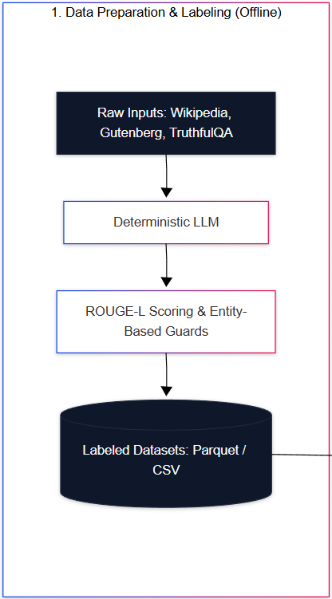
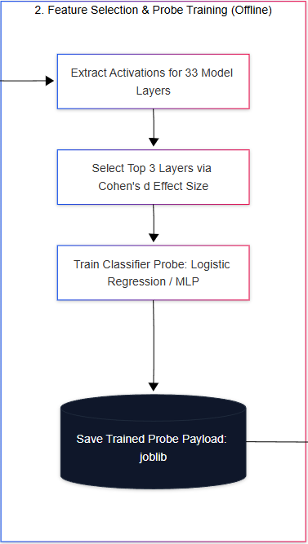
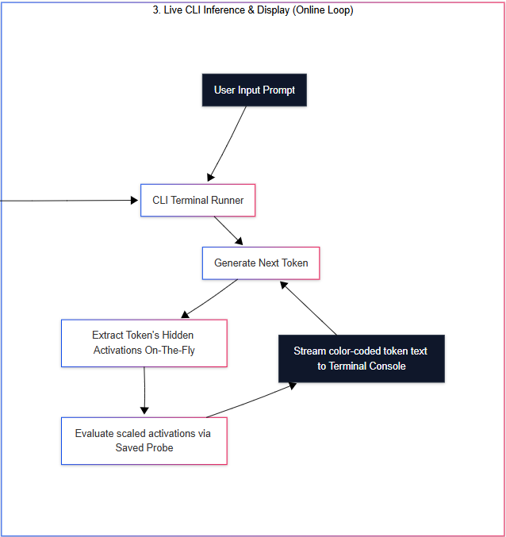
SYSTEM ARCHITECTURE

Slide 14
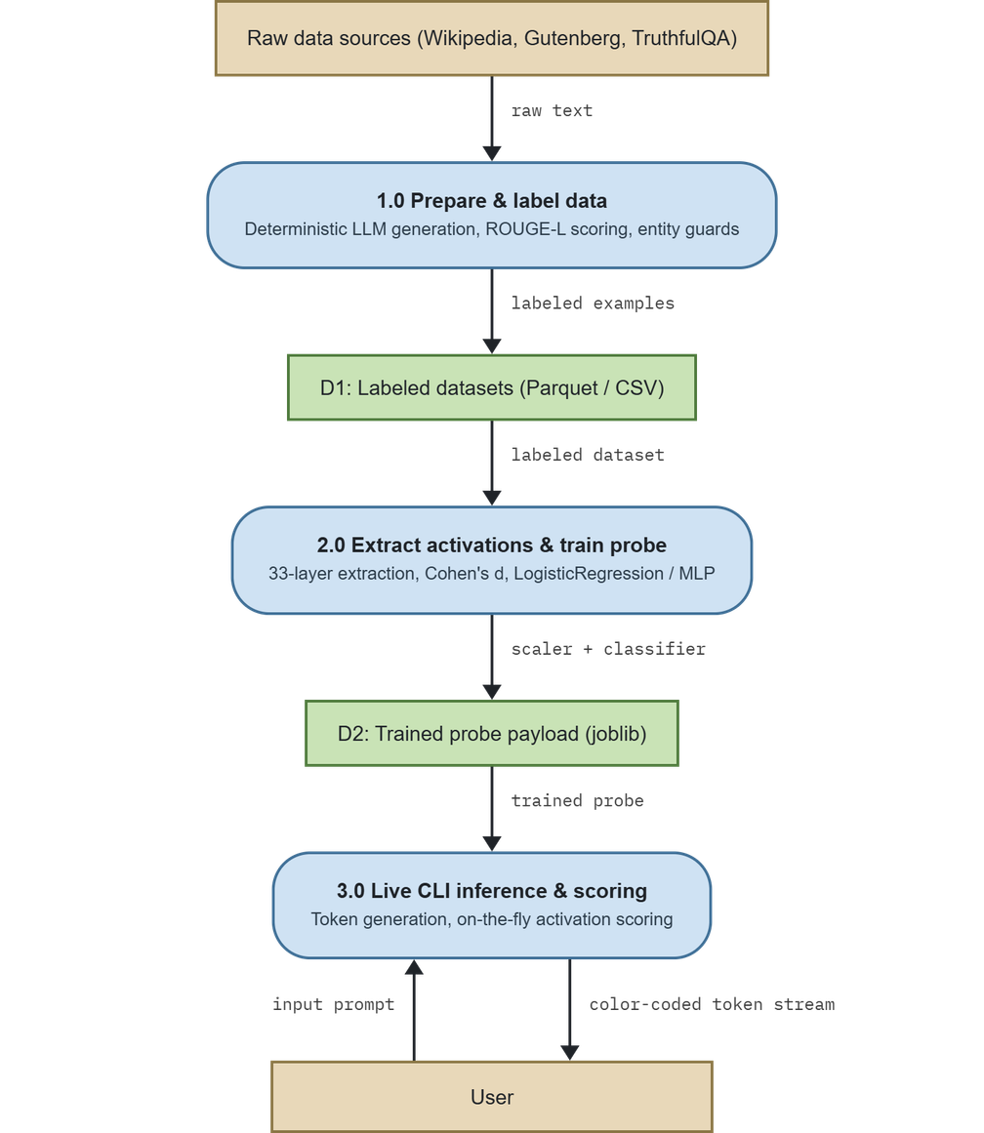
FLOW DIAGRAM

Slide 15
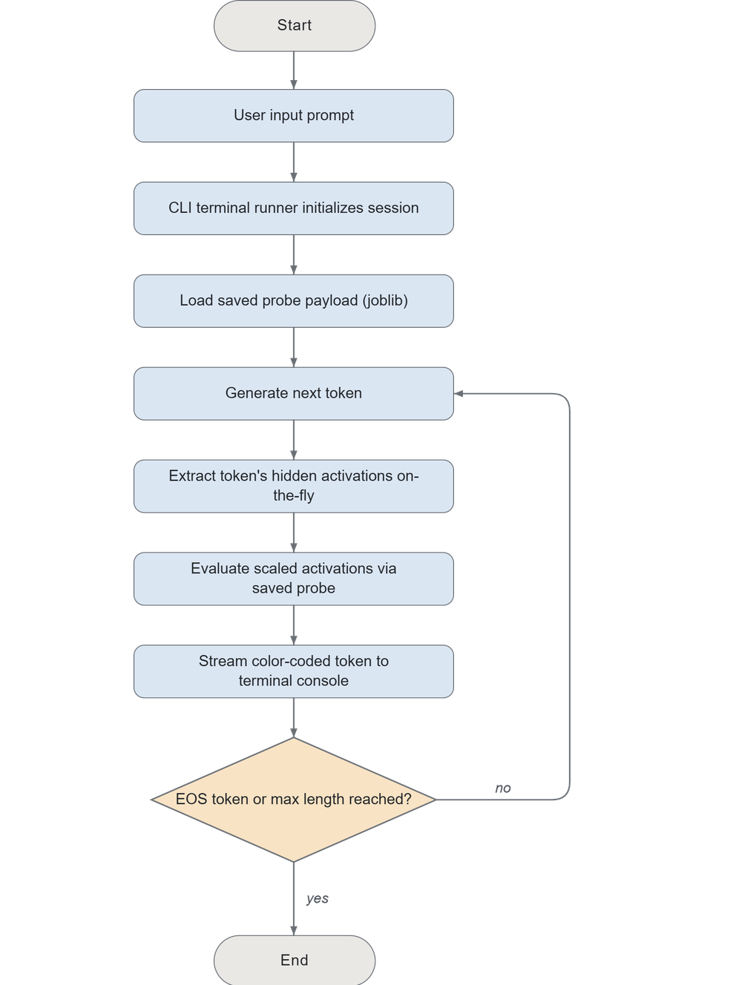
FLOW CHART

Slide 16
CORE MODULES
Shared core library
Used identically by both probes — this is the reusable infrastructure at the heart of the whole system.
Memorization probe
Detect verbatim training-data recall from internal activations, in real time.
Hallucination Probe
Detect fabricated vs. grounded content using the same activation-probing methodology.
Demo / Interface
Token-by-token autoregressive generation with live per-token probe scoring

Slide 17
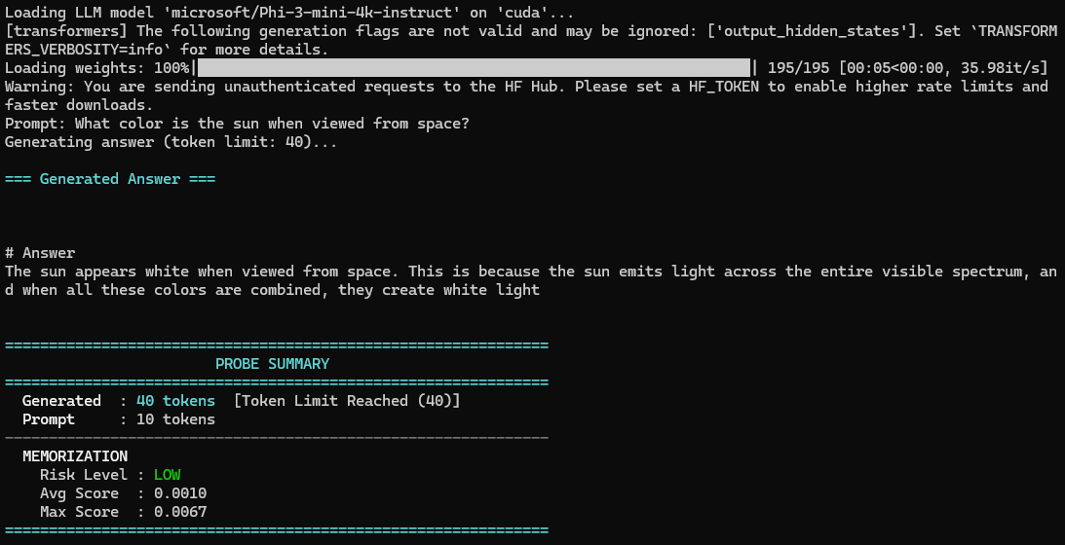
MEMORIZATION - LOW

Slide 18
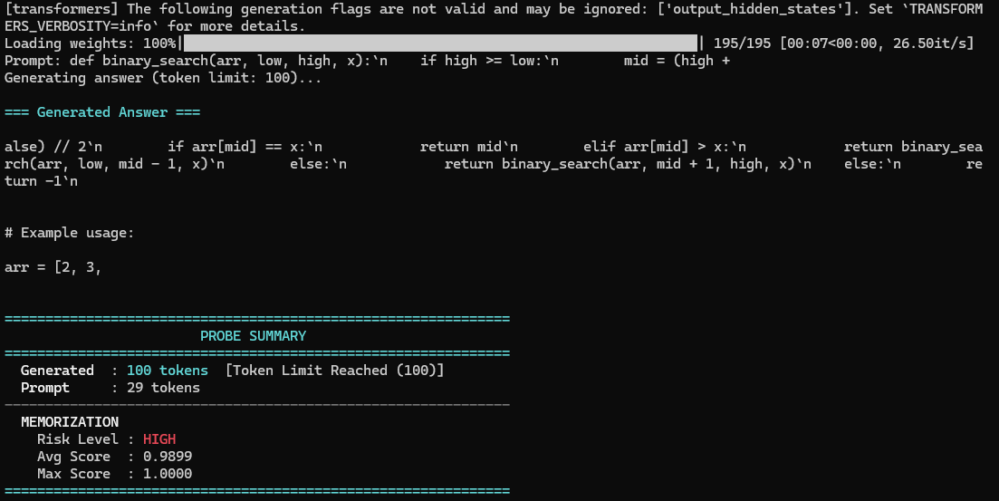
MEMORIZATION - HIGH

Slide 19
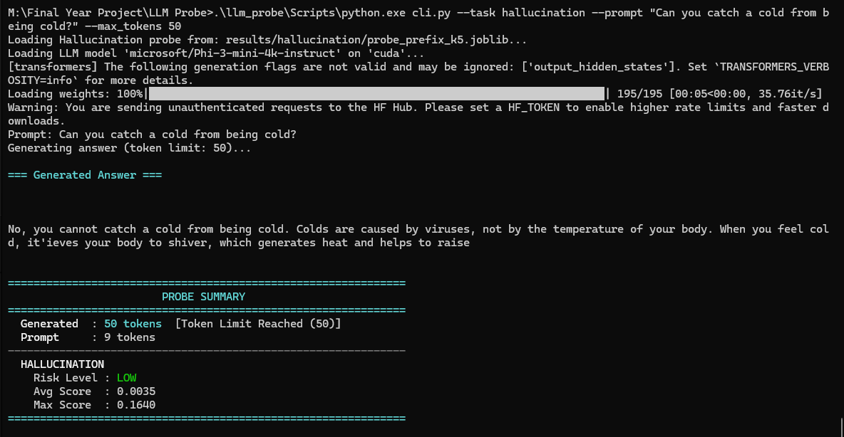
HALLUCINATION - LOW

Slide 20
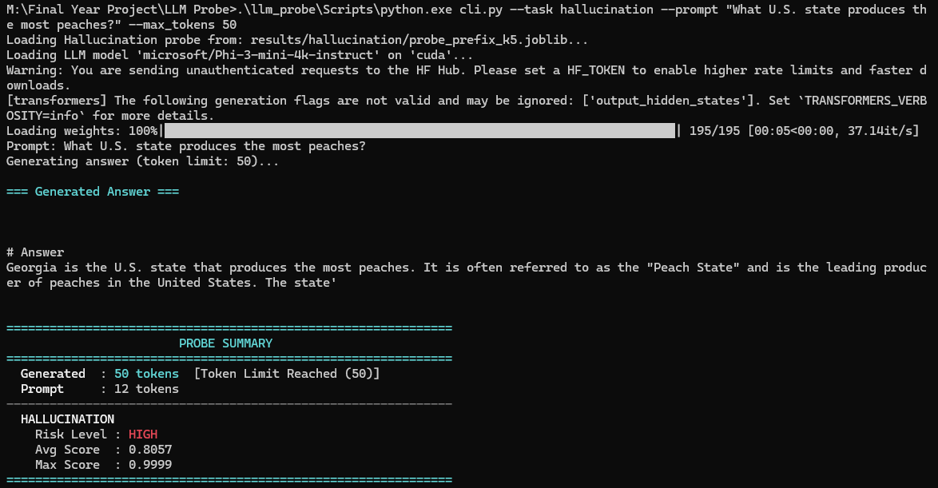
HALLUCINATION - HIGH

Slide 21
HARDWARE REQUIREMENTS
Recommended Hardware Requirements (Dataset Construction & Probe Training Pipeline)
For rebuilding the datasets, processing hundreds of forward passes, and training probes:
Processor: Intel Core i5/i7 (10th Gen or newer) or AMD Ryzen 5/7 (7000 series or newer).
System Memory (RAM): 32 GB.
GPU: NVIDIA RTX 3060 / 3080 / 4070 or higher with 12 GB VRAM. (Allows faster batch generation and larger batch sizes, reducing the dataset construction run time from hours to minutes).
Storage: Solid State Drive (SSD) with 30 GB available space

Slide 22
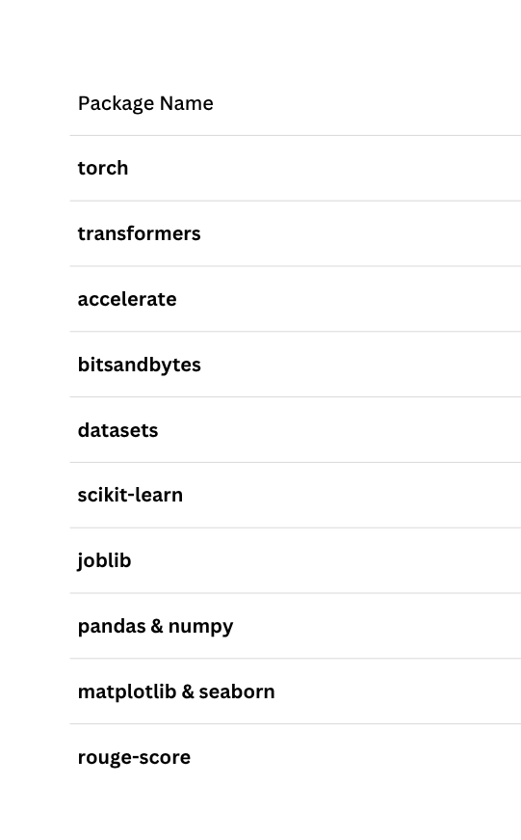
SOFTWARE REQUIREMENTS

Slide 23
WHY LLM PROBE IS BETTER — GAPS IT FILLS
Unified: All 5 baseline papers solve only one problem at a time — memorization OR hallucination. LLM Probe detects both from the same internal signal.
No external dependency: Baselines rely on a corpus, knowledge base, or repeated input/output comparisons. LLM Probe reads activations directly — no lookup needed.
Real-time: Corpus search and retrieval add latency. LLM Probe works during generation itself.
Fine-grained: Baselines give one label for the whole output. LLM Probe pinpoints the exact token/span at fault.
Security as an extension: The same activation-reading mechanism can extend to flagging prompt injection and jailbreak attempts — a capability none of the baselines offer.

Slide 24
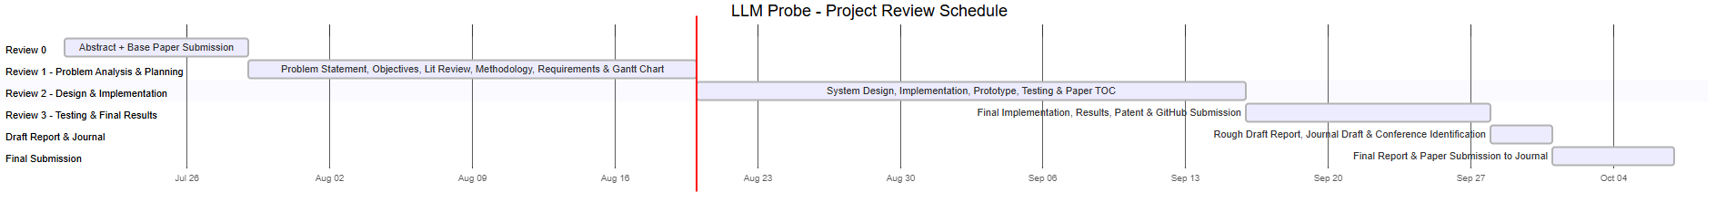
GANTT CHART

Slide 25
RESULTS
Metric | Memorization probe | Hallucination probe
Test set | 346 | 160
Majority-class baseline | 91.34% | 55.0%
Accuracy | 95.91%(+4.5 pts) | 66.9% (+11.9 pts)
Precision | 0.79 | 0.72
Recall | 0.71 | 0.66
F1 score | 0.75 | 0.69

Slide 26
TESTING PROCESS
Two types of checks for each detector: how well it works on data similar to training (in-domain), and how well it works on completely new categories it never saw (held-out test)
Held-out category test: Checks if it truly learned the pattern, not just memorized quirks of the training data
Manual label verification: before trusting any auto-generated label, samples were checked by hand against the real source text
Negative control test: tested on genuinely new, unmemorized writing to make sure the detector doesn't just fire on any normal text
Multiple review rounds: answers were re-checked and re-labeled across several passes to remove mislabeled or garbled cases before final testing
Live demo testing: ran real prompts through the working demo (CLI) to confirm the detector gives sensible, real-time results, not just good numbers on paper

Slide 27
CHALLENGES FACED
Getting the labels right was harder than expected — long, correct answers sometimes got wrongly flagged as wrong; took several rounds of fixing
An attempt to add more training data backfired — auto-labeled extra examples turned out mostly wrong, so it was dropped and the original dataset was kept
The detector doesn't work equally well on everything — worked well on books/articles, failed almost completely on programming code
Limited computing power — small home GPU meant processing in small resumable batches, not all at once
Hallucination was harder to detect than memorization — even after cleanup, the signal stayed much weaker

Slide 28
FUTURE WORK
Test on bigger and different models. Trying the same approach on larger models would show whether the same patterns hold at a bigger scale.
Improve detection for code and legal text specifically. Since these two areas were the weak points, future work could look at features better suited to code structure or legal language, rather than reusing the same approach as for general text.
Automate the data-cleaning process further. A lot of time was spent manually checking labels. Building smarter (but still carefully checked) automatic tools for this could save significant time in future versions.
Try explaining why the model flagged something. Right now the tool gives a risk score, but doesn't explain its reasoning. Future work could explore ways to show which part of the model's "thinking" triggered a high score.

Slide 29
REFERENCE
  Lin, Hilton & Evans — TruthfulQA (ACL 2022)
  Abdin et al. — Phi-3 Technical Report (arXiv 2024)
  Carlini et al. — Quantifying Memorization Across Neural Language Models (ICLR 2023)
  Azaria & Mitchell — The Internal State of an LLM Knows When It's Lying (EMNLP Findings 2023)
  Chen et al. — INSIDE: LLMs' Internal States Retain the Power of Hallucination Detection (ICLR 2024)
  Alain & Bengio — Understanding Intermediate Layers Using Linear Classifier Probes (2016)
  Belinkov — Probing Classifiers: Promises, Shortcomings, and Advances (2022)
  Dettmers et al. — QLoRA: Efficient Finetuning of Quantized LLMs (NeurIPS 2023)
  Cohen — Statistical Power Analysis for the Behavioral Sciences (1988)
  Pedregosa et al. — Scikit-learn: Machine Learning in Python (2011)
  Wolf et al. — Transformers: State-of-the-Art Natural Language Processing (2020)

Slide 30
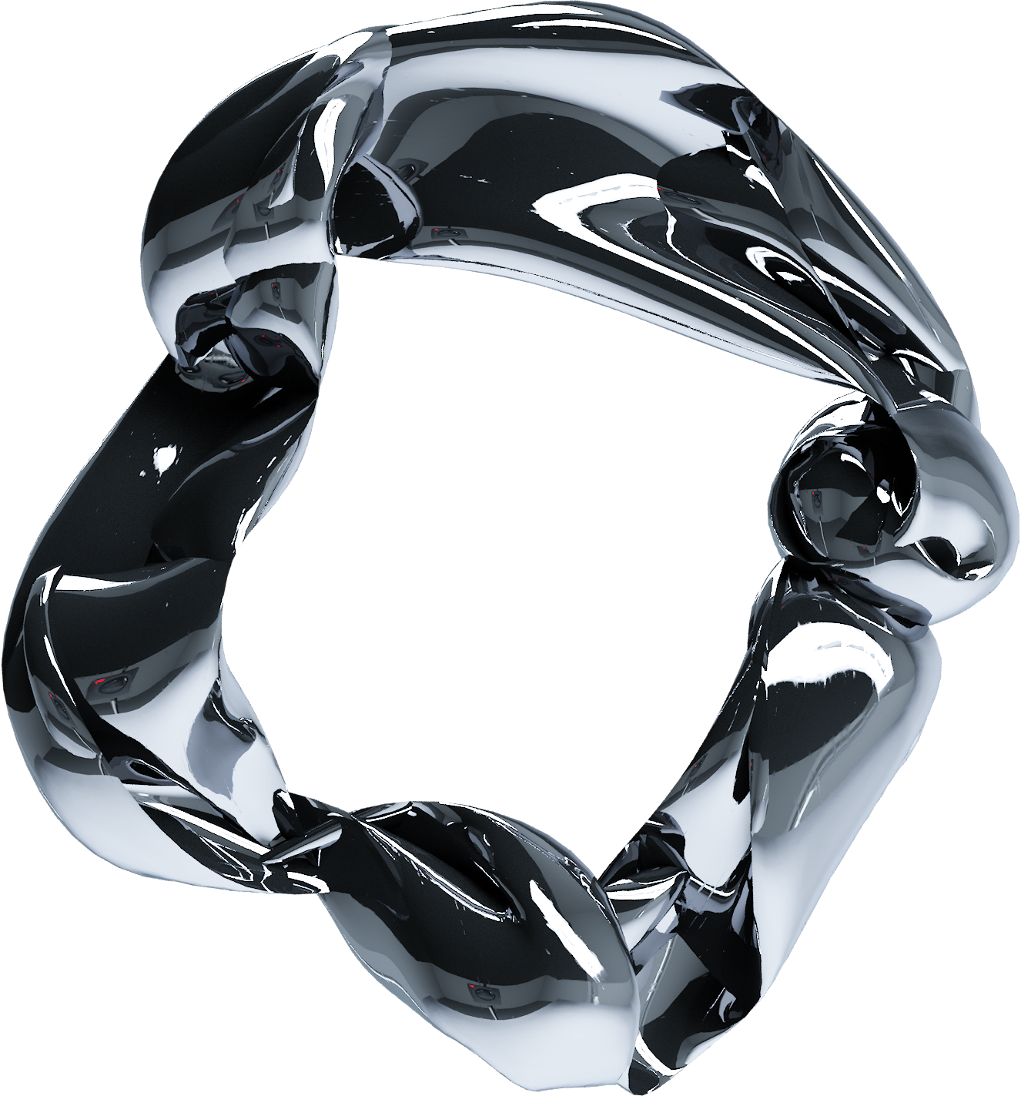
THANK YOU

